Slide 1
Container Ontology
Robert P. Goldman
rpgoldman@sift.net
11 March 2022

Slide 2
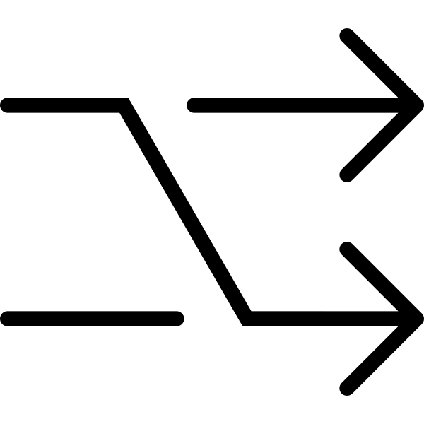




Expected Use Pattern (Tentative!)
Container
Ontology
OpenAPI Interface
PAML-based tools
Container API
Container Server
Queries
PAML-based tools will want to be able to choose containers to meet protocol requirements.
PAML protocols will contain container requirements, at varying levels of detail.
Container server will answer queries about which containers meet the requirements.
Local databases
(optional)
Local
Extensions
Web Browser

Slide 3
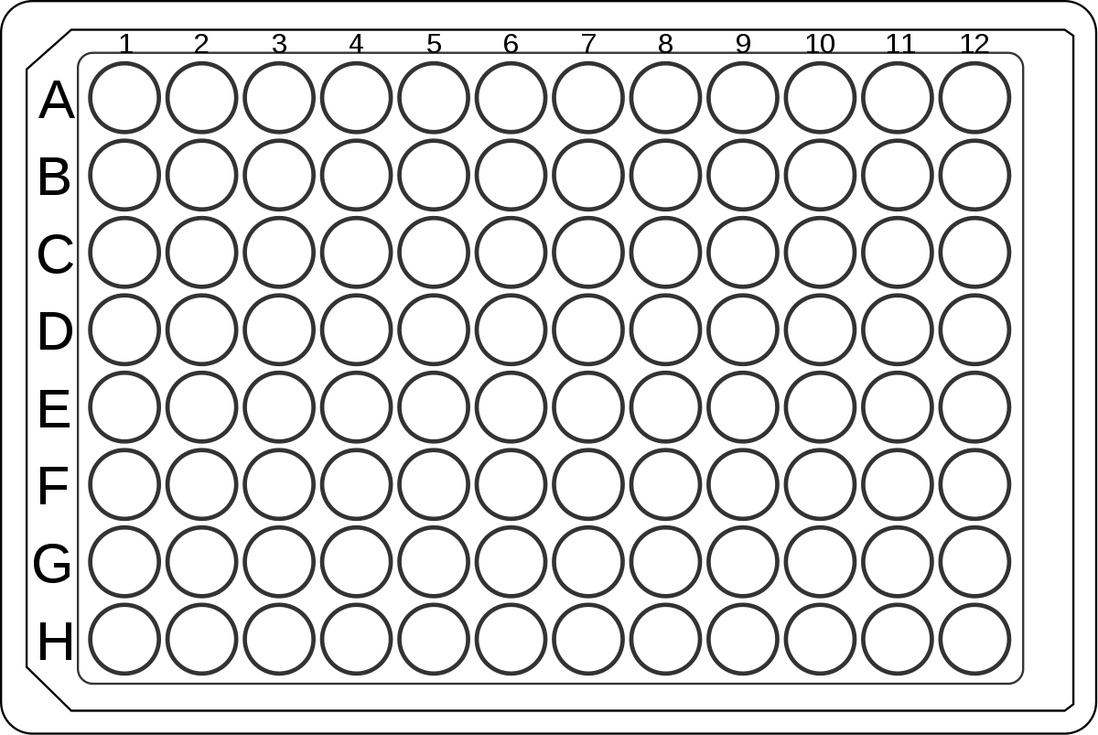
Structure of the Container Ontology

Slide 4
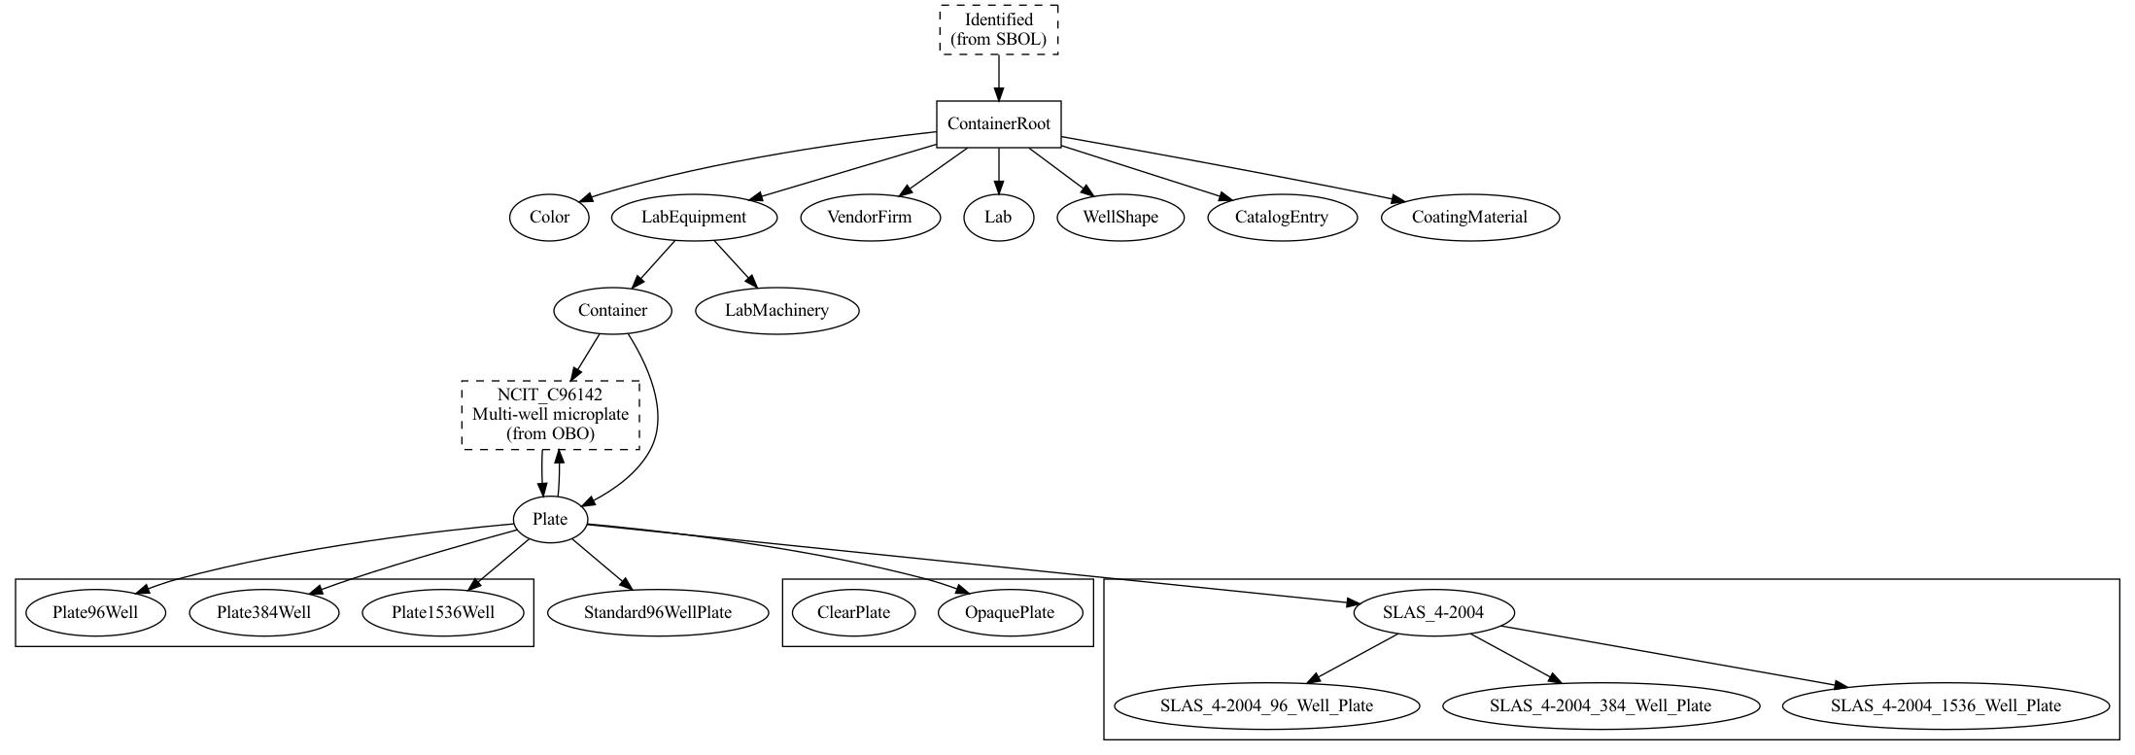
Fundamental classes
Connect to SBOL ontology – necessary?
For property values
Number of wells
Standard row/column layout
Clear vs. Opaque

Slide 5
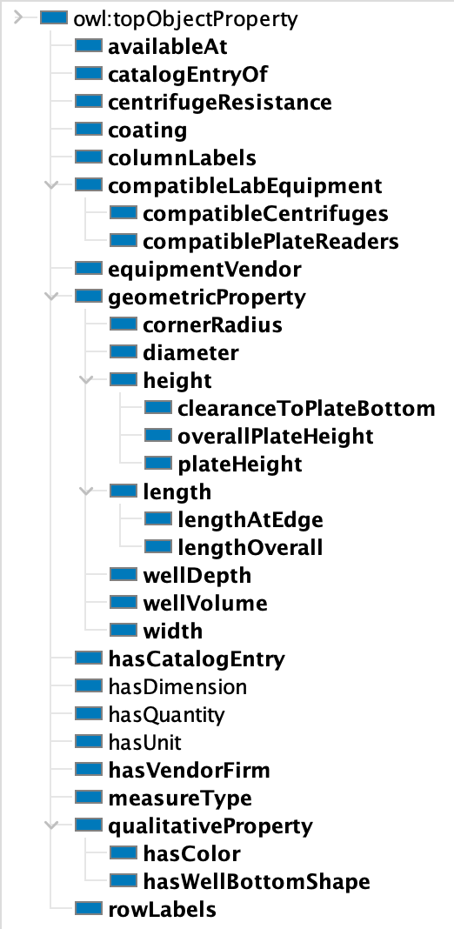
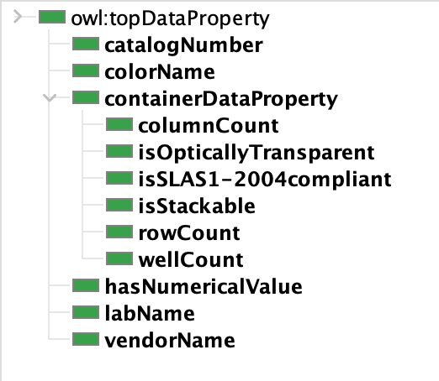
Key Microplate Properties for Classification
Object Properties
Data Properties

Slide 6
Classes and properties were chosen in consultation with a very small sample of practitioners. They undoubtedly need more work.
Add something like a capability link that links somehow to PAML tasks.
Which are the first additional directions to go when extending the ontology?
More containers, beyond microplates?
What properties are critical for determining suitability of microplates and other containers?

Slide 7

OWL and the container ontology

Slide 8
Why OWL?
OWL is based on description logic (DL) and is designed to efficiently answer queries like
“How should an object with this set of properties be categorized?” and
“What objects fit this description?”
Suitable for web-hosted, shared information.
Already used in SBOL and PAML.
But because of its DL ancestry, OWL is unusual in many ways. We’ll review them now.

Slide 9
OWL fundamentals
OWL provides a means to create data models to be shared across the web.
It does this by giving every named thing a URL/URI/IRI
OWL has Classes with Inheritance (subclasses), and Individuals (the instances of classes).
Individuals have Properties, and Classes can put constraints on Properties, notably constraints on allowed values and cardinality (number of values).

Slide 10
OWL is a Logic, not a Programming Language
OWL uses words like “class” that suggests it’s like Java, Python, etc.
It’s not.
“In linguistics, the informal term false friends refers to pairs of words in two languages (or in two dialects of the same language) that look and/or sound the same but have different meanings.”[Nordquist, 2019]
OWL’s terminology is full of false friends.

Slide 11
Unusual Things About OWL
OWL is based on description logic (DL).
The central problem for DLs is classification.
Given a description of an Individual or Class, an OWL reasoner will identify its classes or super-classes, respectively.
Conversely, give an object’s (class’s) classes (super-classes) and the reasoner will extrapolate some properties, but only existentially.
An OWL reasoner will perform both inferences over loaded ontologies.
OWL cardinality restrictions are existential.
I can tell you that Cars have four wheels. That doesn’t mean that an OWL database must have four wheel Individuals, just that we know that these entities must exist.
OWL is an open world scheme.
Just because my ontology does not know the Individual that is the right front wheel of my car, does not imply that there is no such wheel, only that I don’t know what it is.
OWL descriptions can be definitional (necessary and sufficient conditions) or just descriptive (necessary conditions only).
A 96 well microplate is a microplate with 96 wells.
Someone living in my immediate neighborhood has the ZIP code 55408, but so do others.

Slide 12
Unusual Things About OWL, cont’d
OWL makes extensive use of multiple inheritance.
Restrictions on Properties are done by means of inheritance.
Plate222 is a subclass of the class of plates that are 12mm high.
Properties are either Data properties or Object properties.
Properties don’t “belong” to classes: they are free-standing entities, not “slots” or “methods.”
Properties may have domain and range constraints.
But their domain need not be a simple class. A domain could be “the set of microplates colored blue or orange.”
There is no overriding: OWL is monotonic.
E.g., if you say “birds fly,” you cannot say “penguins are birds that don’t fly.”
“Description logic” might more accurately be called “Definition logic.”
OWL is probably OK for biological equipment, as here, but not for biological organisms (or other “natural kinds”), or at least not great for them.

Slide 13
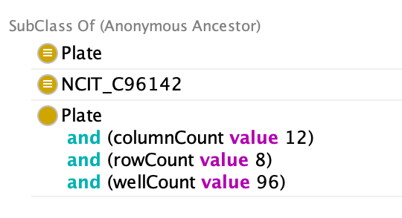
Example: Standard 96 Well Plate
Plate
SLAS 4-2004
96 Well Plate
“Things with height between 13.5mm and 15.25mm”
SLAS 4-2004 class (light blue) defines standard well layout (rows and columns).
Green node is a Restriction that specifies allowable values for the height of Standard 96 Well plates.
Standard 96 Well Plate
Class: cont:Standard96WellPlate
EquivalentTo:
cont:Plate
cont:SLAS_4-2004_96_Well_Plate
and (cont:height some
((om2:hasDimension value om2:millimetre)
and (om2:hasNumericalValue some
xsd:decimal[>= 13.5 , <= 15.25])))
Classification Inferences:

Slide 14
OWL Examples
For the container ontology

Slide 15
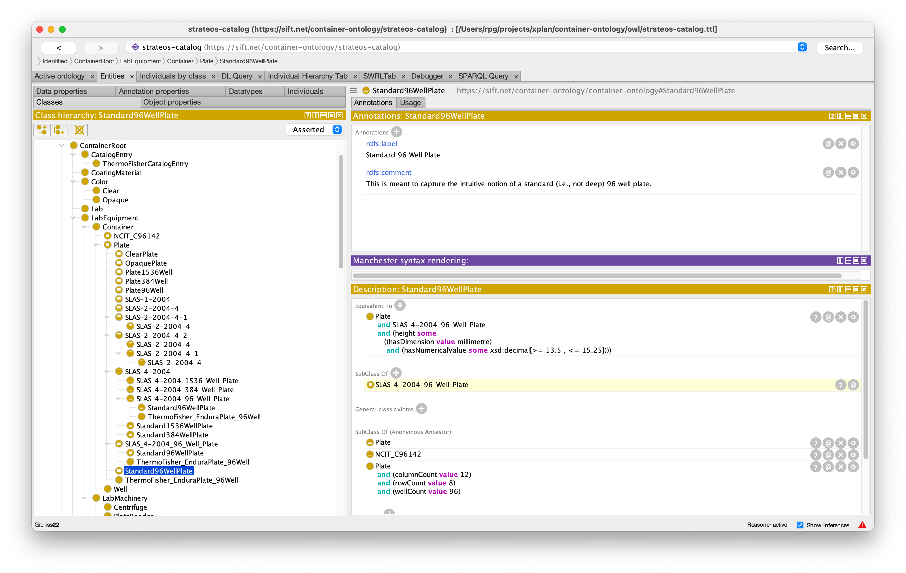
Protégé is the Most Commonly-Used OWL Ontology Editor

Slide 16
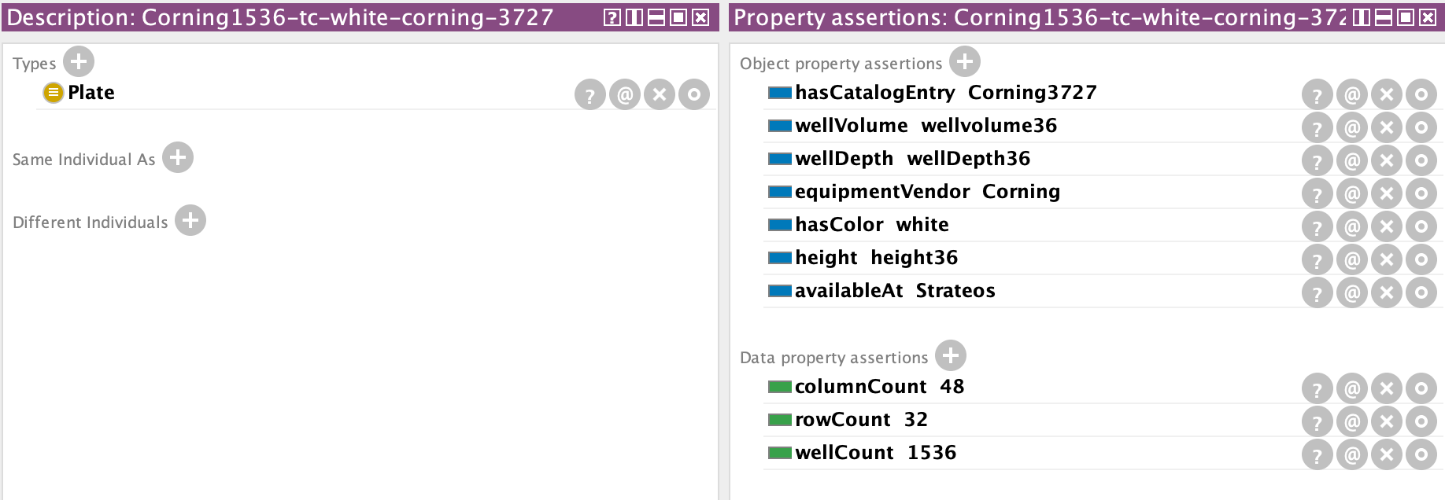
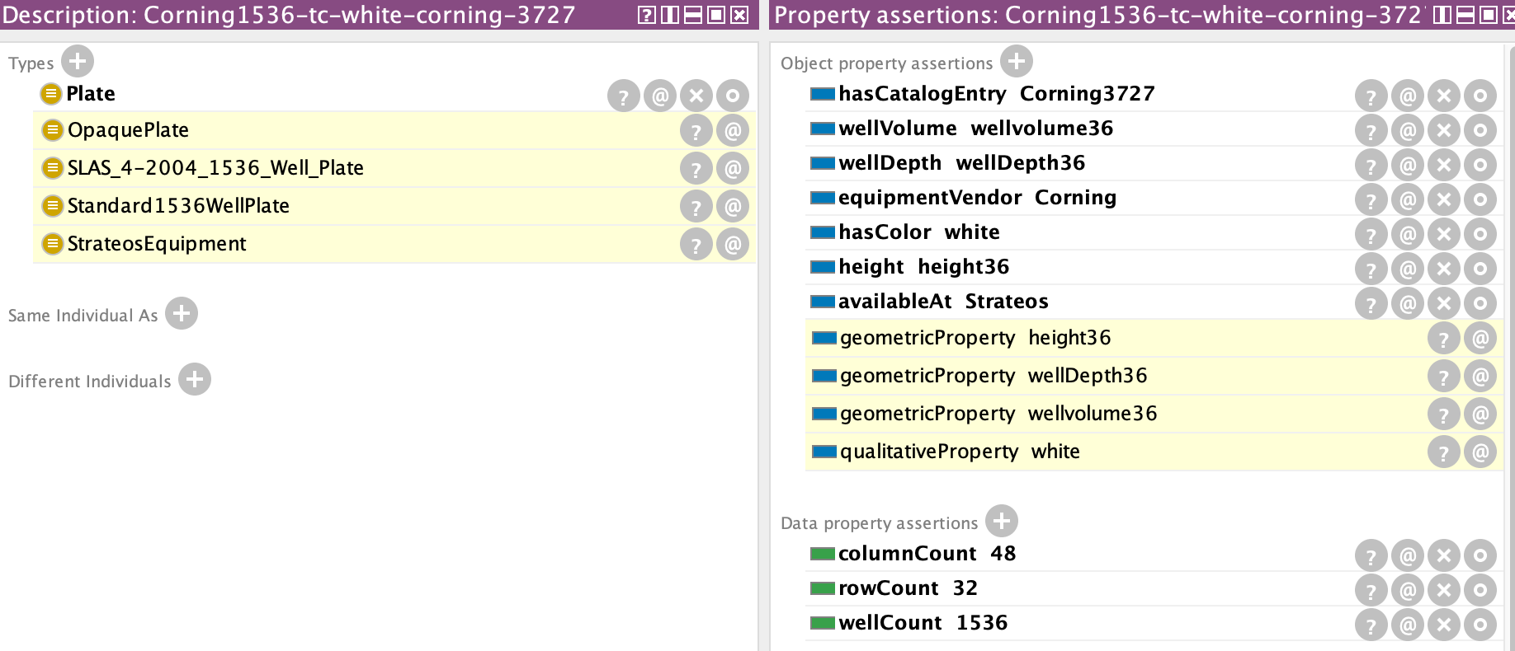
Classifying Objects
Input description of plate from Strateos catalog
Now we know that this plate is suitable if we ask for an opaque standard 1536 well plate that is available at Strateos.
Classification of plate.

Slide 17
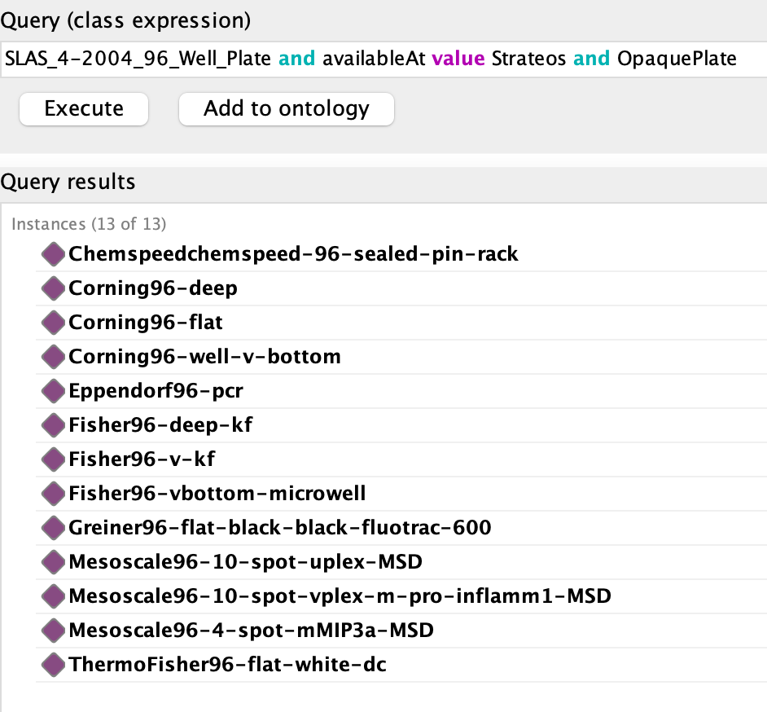
Finding Containers

Slide 18
Using the Container Ontology Server

Slide 19
Expected Use Pattern (Tentative!)
Container
Ontology
OpenAPI Interface
PAML-based tools
Container API
Container Server
Queries
Local databases
(optional)
Local
Extensions
Web Browser

Slide 20
How to Use Today
Clone the Container ontology from GitHub
Start the server using the Makefile ( make server )
Use the OpenAPI interface to explore (🙁 – not user friendly)
Install the Python API
pip install ./container-ontology
Must be local install; not on PyPI (yet).
Run test example
server must be running
python –m container-api
More details in README on GitHub

Slide 21
Questions?
Suggestions?
Corrections?

